Slide 1
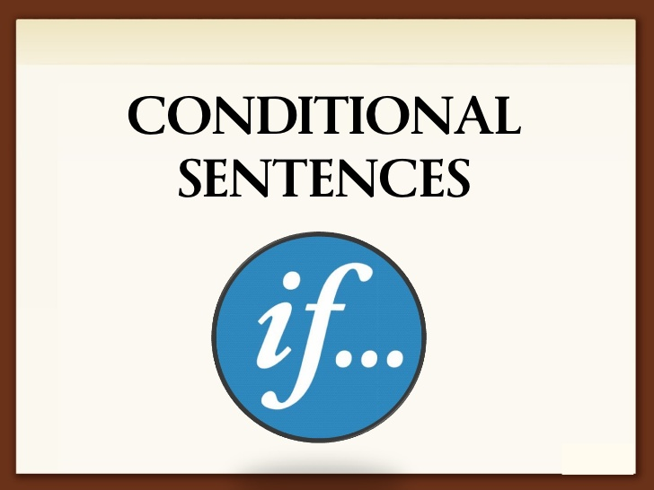

Slide 2
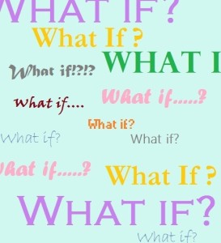
A conditional sentence says that an action is reliant on something else. One part of the sentence expresses the condition and the other expresses the consequences.
The conditionals are used to talk about real or unreal situations, they are sometimes called “if-clauses”.
There are four basic conditionals but we are going to learn three of them: Zero Conditional, Type 1 Conditional (First Conditional), and Type 2 Conditional (Second Conditional).

Slide 3
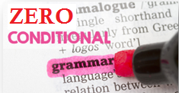
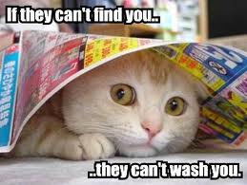
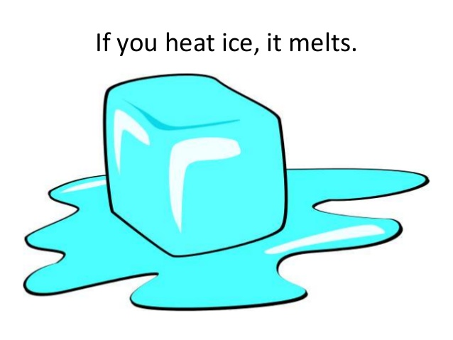
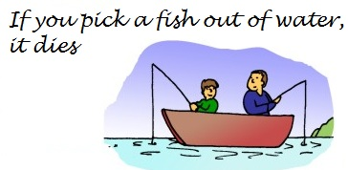

Slide 4
We use the Zero Conditional to talk about things that are always true, scientific facts or things which always happen under certain conditions.
If you heat water, it boils.
When the sun goes down, it gets dark.
If I wake up early, I go jogging.
If you freeze water, it turns into ice.
Form:
If (when) + Simple Present + Simple Present

Slide 5


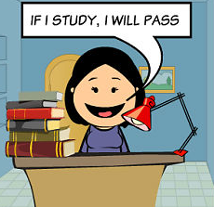
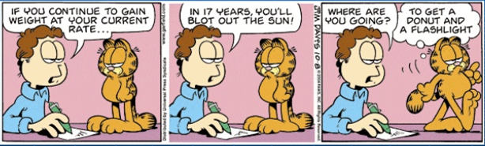

Slide 6
First Conditional is used when we talk about real or possible situations. This conditional type of sentence refer to the future. An action in the future will only happen if a certain condition is fulfilled by that time.
I’ll go shopping on my way home if I have time.
If it’s a nice day tomorrow we’ll go to the beach.
If Arsenal wins, they’ll be top of the league.
If it rains today, I’ll stay at home.
Form:
If (when) + Simple Present + Simple Future

Slide 7
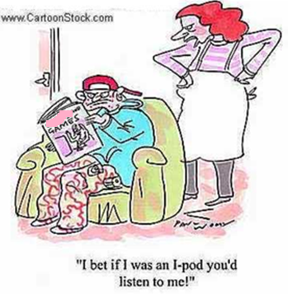
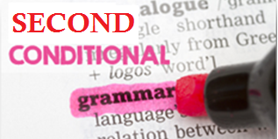
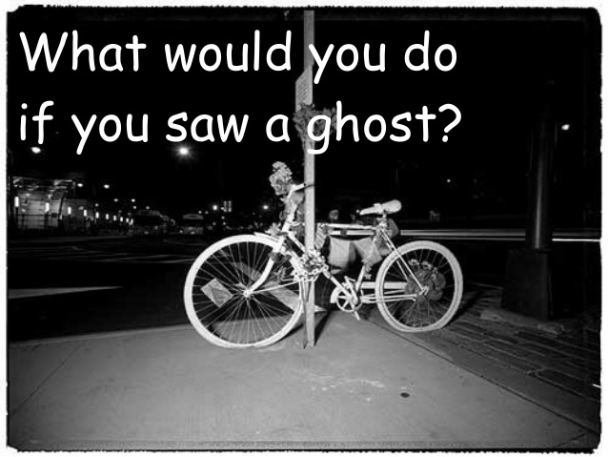
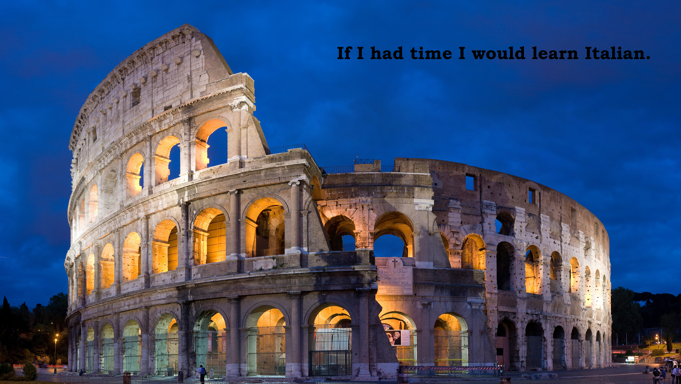

Slide 8
The Second Conditional is used to talk about “unreal” or impossible or improbable situations. This conditional provides an imaginary result for a given situation. It is very unlikely that the condition will be fulfilled.
If I won a lot of money I’d buy a big house in the country.
Where would you live if you could live anywhere in the world?
If you didn’t smoke so much you’d feel a lot better.
If they had more money they would buy a new car.
Form:
If (when) + Simple Past + Would + base form of the verb

Slide 9
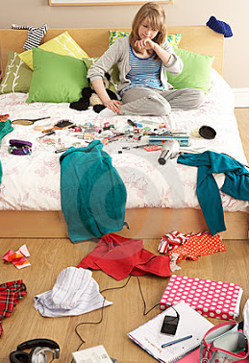
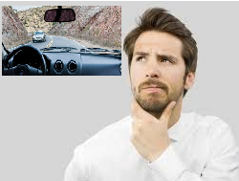

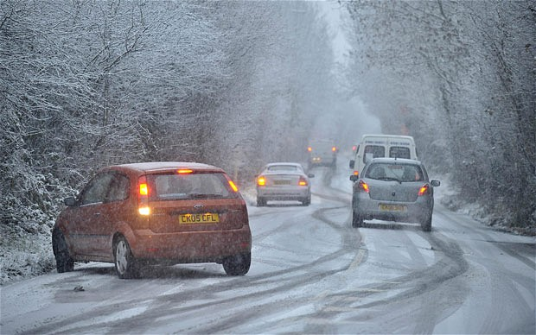

Complete the sentences with the correct forms of the verbs in brackets.
You ____________________ (not go out) if you (not tidy) ______________________ your room.
If I _______________ (have) a car, I (go) ______________________on a long journey.
If I ____________________ (not have) to work so much, I ______________________ (not be) so tired.
When it ____________________ (snow) the roads ______________________ (get) slippery and dangerous.
If they ____________________ (work) hard, they ______________________ (finish) the project on time.

Slide 10
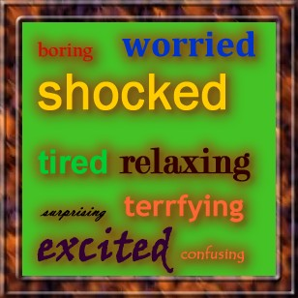
Participial adjectives

Slide 11
Many verbs of emotion have –ing and –ed adjective forms. Some verbs of emotion are: amuse, annoy, bother, captivate, irritate, surprise, confuse, depress, tire, shock, fascinate, interest, puzzle, disappoint, satisfy, amaze, etc.
These verbs can be changed to adjectives by changing the spelling:
You amaze me! (verb)
These students are amazing! (adjective)
I am amazed by the students in this class! (adjective)
Computers interest her. (verb)
Computers are interesting to her. (adjective)
She is interested in computers. (adjective)

Slide 12
What’s the difference between –ing and –ed adjectives?
We use –ing adjectives to describe a person, a thing or things that cause the emotion:
The movie was amazing.
We use –ed adjectives to describe the person or thing that experiences the emotion, feeling or reaction:
I was really amused by the movie.

Slide 13

(Frustrate) The woman is _______________.
The computer is _____________ to her.

Slide 14
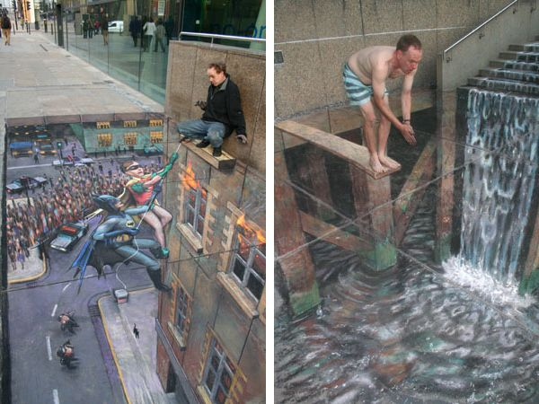
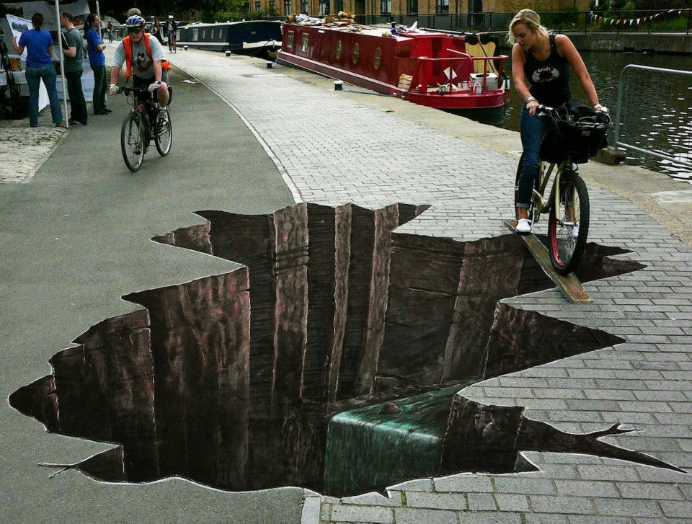
(Fascinate) Julian Beever’s street art is ____________.
I am ________ by Julian Beever’s street art.

Slide 15
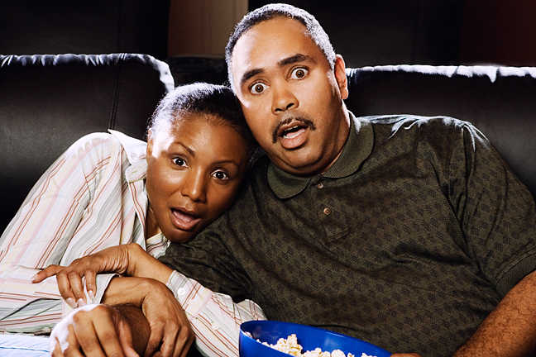
(Frighten) The movie is ________________.
They are ________________.

Slide 16


Slide 17
Conditional Sentences Type 0, 1 and 2:
http://www.ompersonal.com.ar/INTERMEDIATE/unit10/page4.htm (type 1)
http://www.ompersonal.com.ar/INTERMEDIATE/unit10/page5.htm (Reading Comprehension)
http://www.ompersonal.com.ar/INTERMEDIATE/unit18/page4.htm (type 2)
http://www.ompersonal.com.ar/INTERMEDIATE/unit18/page5.htm (type 2)
http://www.englisch-hilfen.de/en/exercises/if_clauses/mix.htm (type 1 and 2)
Participial Adjectives (“ed” and “ing”):
http://www.ompersonal.com.ar/INTERMEDIATE/unit14/page3.htm (second part of the page)

